Slide 1
WEST OF ENGLAND
INSTITUTE OF TECHNOLOGY
SKILLS FOR OUR DIGITAL FUTURE
Learner Induction Academic year 22/23

Slide 2
WELCOME
Industry, education and research collaborating to design and deliver flexible, higher-level technical learning
You are a part of a group of learners joining the
West of England Institute of Technology (WEIoT) Programme
Notes:
Smile and Welcome the Learners
Introduce yourself
Explain that they are registered and looked after by their home Institution, but you are Associated with the IoT
This will not affect your degree or other qualifications – its demonstrating the reach and support that the IoT has had

Slide 3
WHAT IS THE WEST OF ENGLAND INSTITUTE OF TECHNOLOGY (WEIoT)?
Industry, education and research collaborating to design and deliver flexible, higher-level technical learning
The WEIoT has been designed to support businesses across the region to thrive and embrace the opportunities of the digitalisation of the economy.
One of only 12 national Institutes of Technology licenced by the Department for Education.
(21 planned by Dec 23)
Working as a partnership across the region developing the future talent of tomorrow, by training and developing the workforce today.
Supporting local employers develop higher level skills and train employees for the jobs of tomorrow.

Slide 4
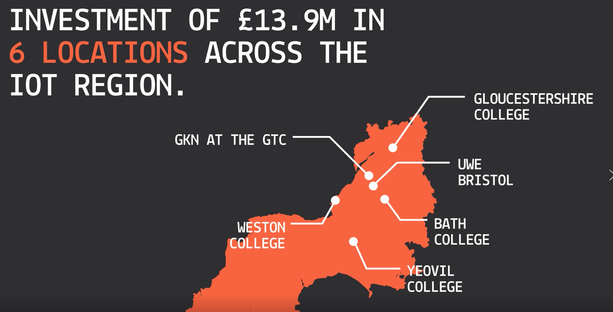
IoT – Investmentt
Notes:
Map shows the Partners of the IoT and their investments for the current delviery locations for the West of England IoT.
Talk about the relevant investment for your Institution.

Slide 5
WEIoT PARTNERS
EMPLOYER PARTNERS
EDUCATION PARTNERS
Notes:
IoT are supported by a number of Anchor Employers who commit to support the IoT and their learners – whether they are Apprentices or Full time or Part time learners .
Tailor as relevant to the student group

Slide 6
SECTORS
Notes:
Partners to confirm that these are still correct for their organisation – Action all

Slide 7
ACCESS TO STATE OF
THE ART FACILITIES
LINKS TO LOCAL
EMPLOYERS WITHIN THE RELEVANT INDUSTRY
State of the art [ add your content ]
Brand NEW [add your content]
Work experience
World-class [add SECTOR] provision
Access to employers’ premises to access cutting
edge technology and develop new skills
Anything else
Guest lectures
A dedicated workspace for IoT
learners to work in
Other support being planned
Notes:
FOR EDIT for the Partner to customise as appropriate

Slide 8
WHAT NEXT?
ENJOY YOUR COURSE
YOU ARE AN ‘ASSOCIATE LEARNER’
SHORT LEARNER SURVEY IN DEC 22 / JAN 23
ANY QUESTIONS?
Institution first
EMAIL: INFO@WEIOT.AC.UK
Notes:
Issue Pin Badges with the Instructions
QR Code to capture details
Sign up for newsletter /
Survey ?
INVITE TO A ‘CROSS PARTNERSHIP EVENT’ FOR ALL COURSES AND STARTS LATER IN ACADEMIC YEAR

Slide 9
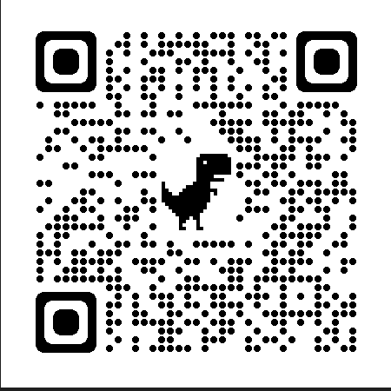
Don’t forget to
QR CODE to be added
Wear your Pin Badge on your Lanyard
Scan QR Code for more details
ANY QUESTIONS?
EMAIL: INFO@WEIOT.AC.UK
Notes:
Issue Pin Badges with the Instructions
QR Code to capture details
Sign up for newsletter /
Survey will follow later in the Autumn

